Slide 1

WAY TO ENTERPRISE
AWS
VTI ACADEMY
Author: duy.nguyenngoc1@vti.com.vn

Slide 2
Agenda
ElastiCache Service
On-premise strategy with AWS
Assignments
Quiz
Copyright © VTI Academy All Rights Reserved

Slide 3
ElastiCache Service
As an distributed in-memory cache environments in the AWS Cloud (Storing data on RAM)
Key-value format
High performance, low latency, resizable, and cost-effective in-memory cache
No need to modify application
Regional service
Price: https://aws.amazon.com/elasticache/pricing/
Tutorial: https://docs.aws.amazon.com/elasticache/index.html

Slide 4
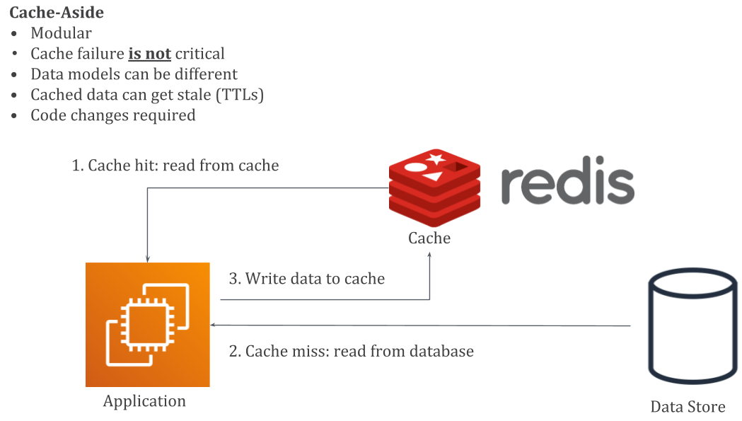
ElastiCache Service
Support Redis and Memcached engines
ElastiCache helps relieve load in RDS

Slide 5
ElastiCache Service
Usecases
  Accelerate application performance
  Access data with microsecond latency and high throughput for lightning-fast application performance
  Ease database load
    Cache your data to reduce pressure on your database
  Build low-latency data stores
    Use ElastiCache to store non-durable datasets in memory and support real-time applications with microsecond latency.

Slide 6
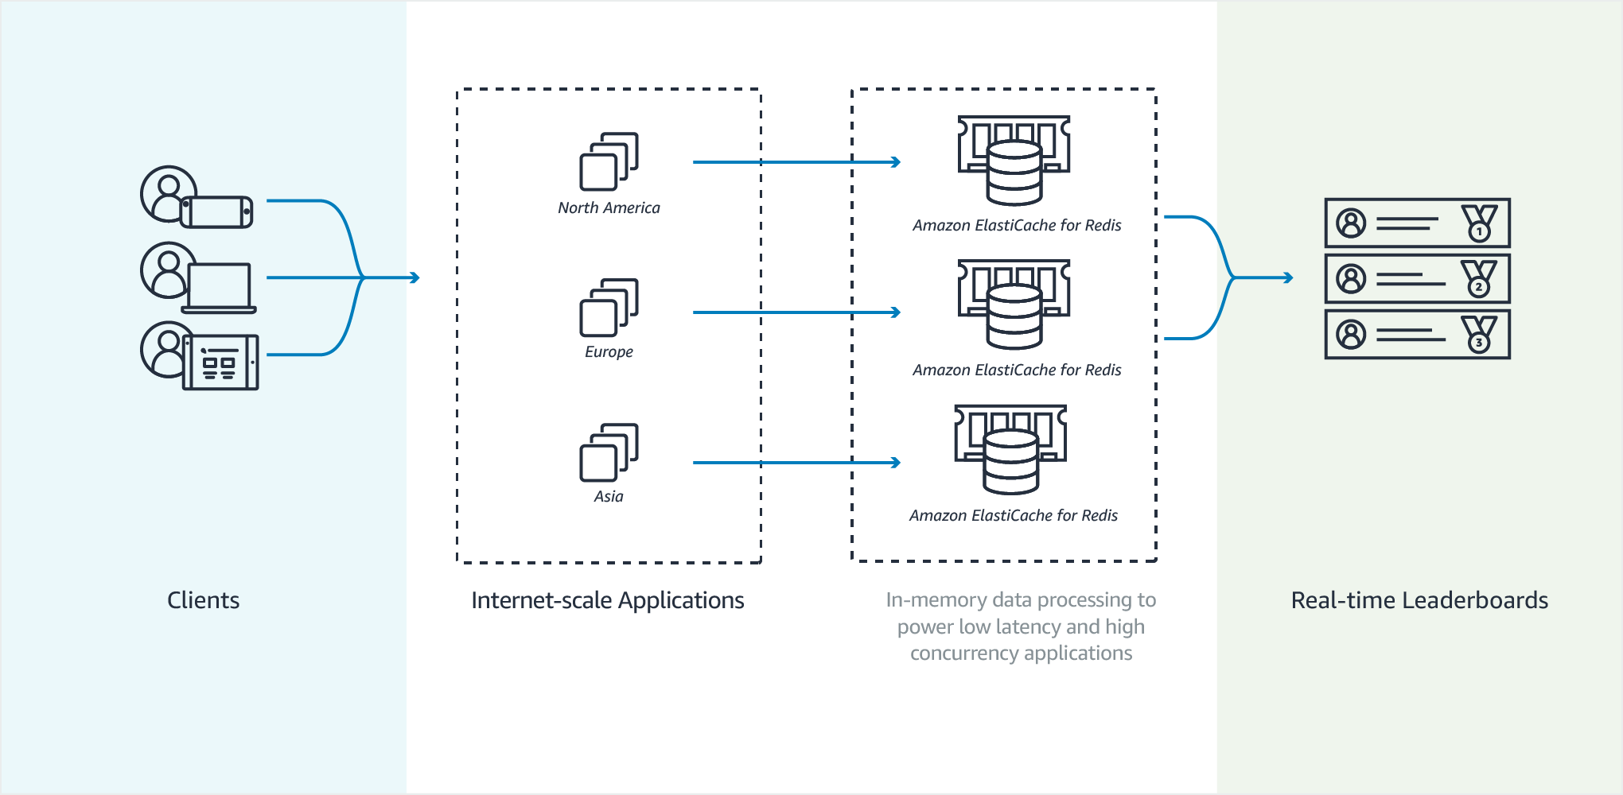
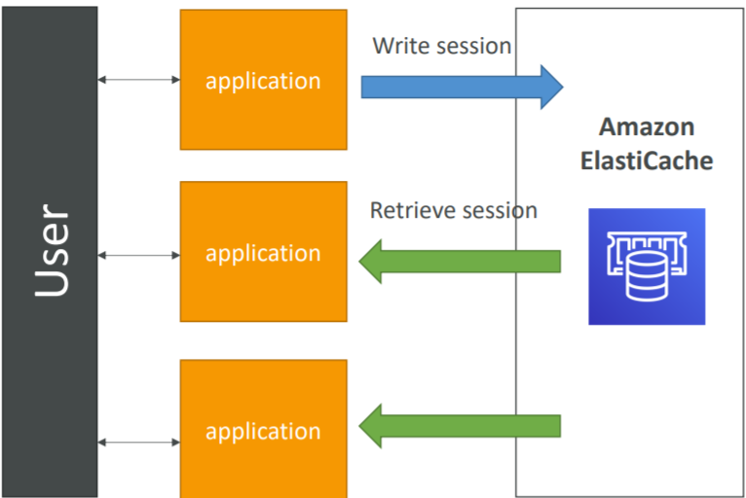
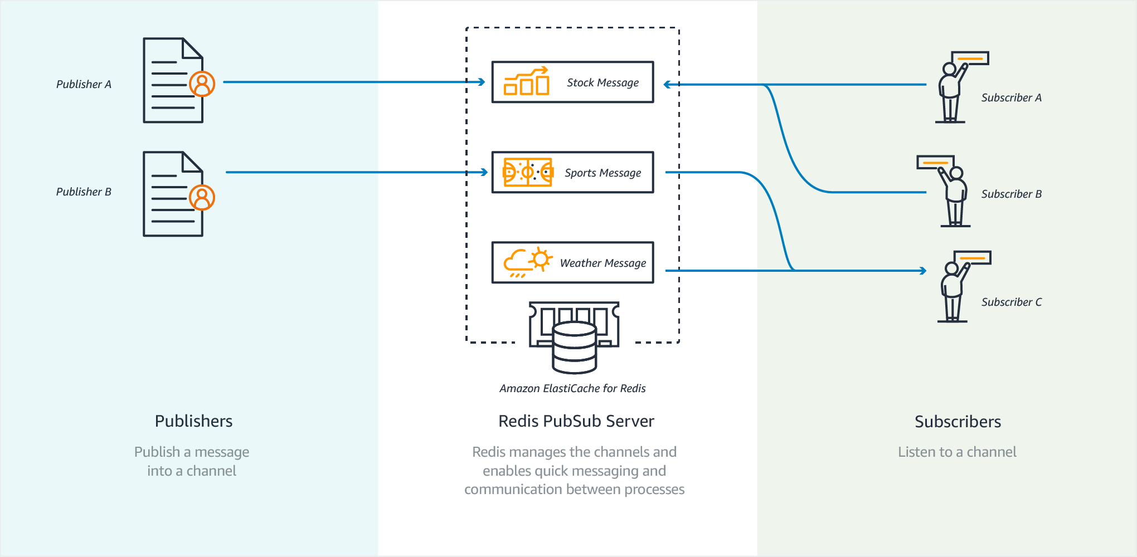
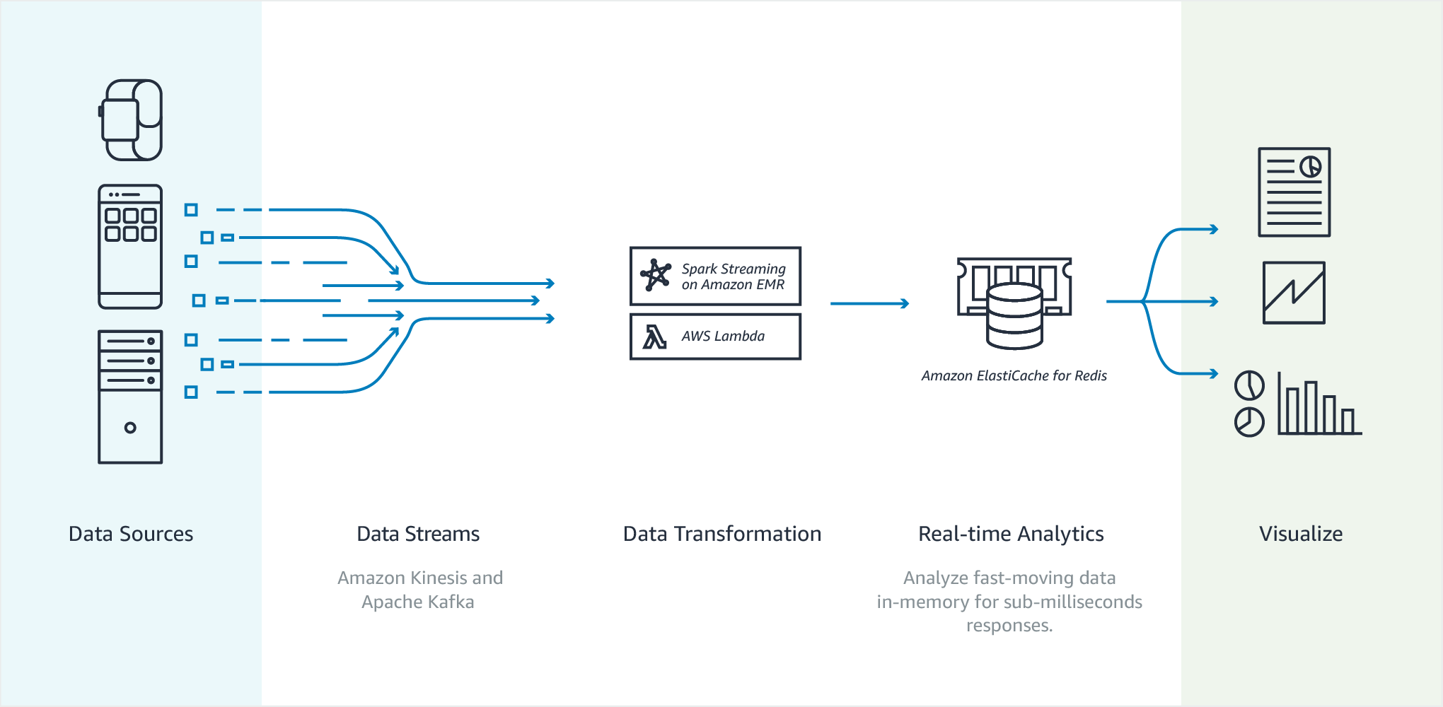
ElastiCache Service
Cache
Session store
Messaging
Real-time data

Slide 7
ElastiCache Service
Redis (REmote DIctionary Server)
  Demo
    Create cluster
    Authorize access to the cluster
    Launch EC2
    Connect to Cluster from EC2 Instance
https://docs.aws.amazon.com/AmazonElastiCache/latest/red-ug/GettingStarted.html

Slide 8
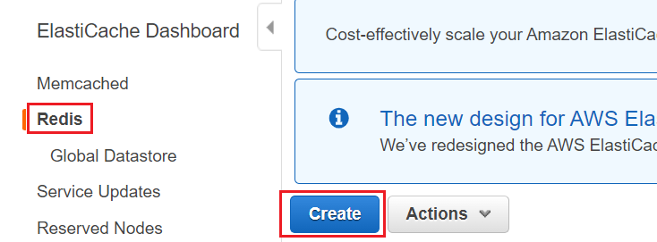
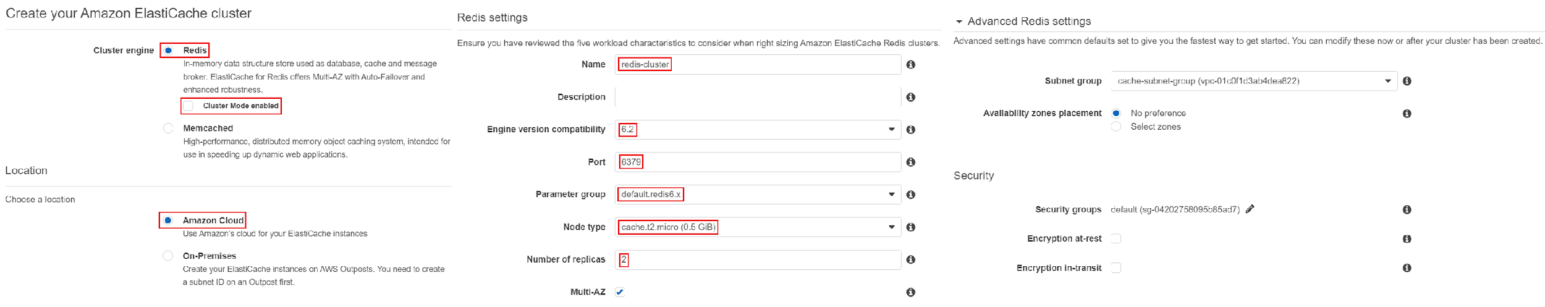
ElastiCache Service
    Create cluster

Slide 9
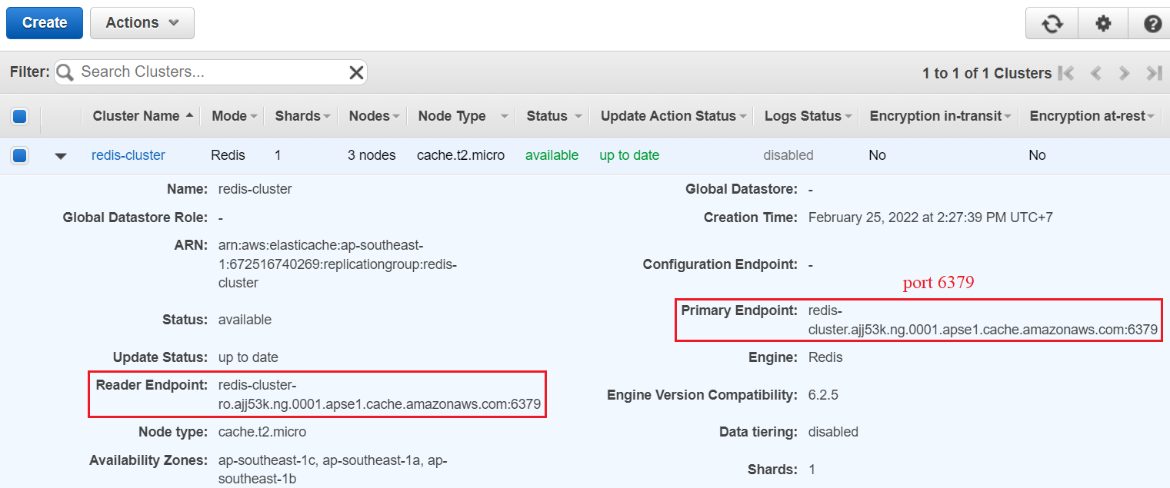
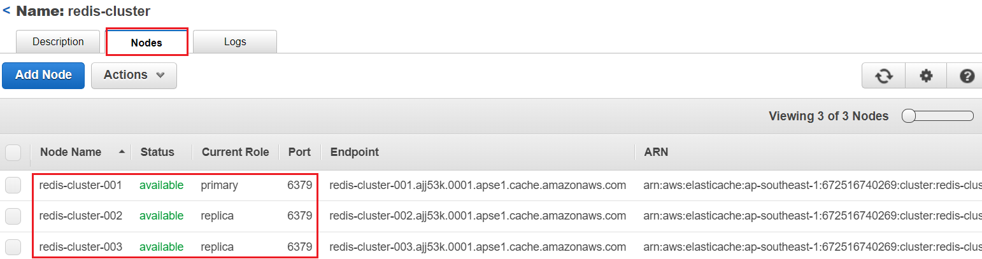
ElastiCache Service

Slide 10
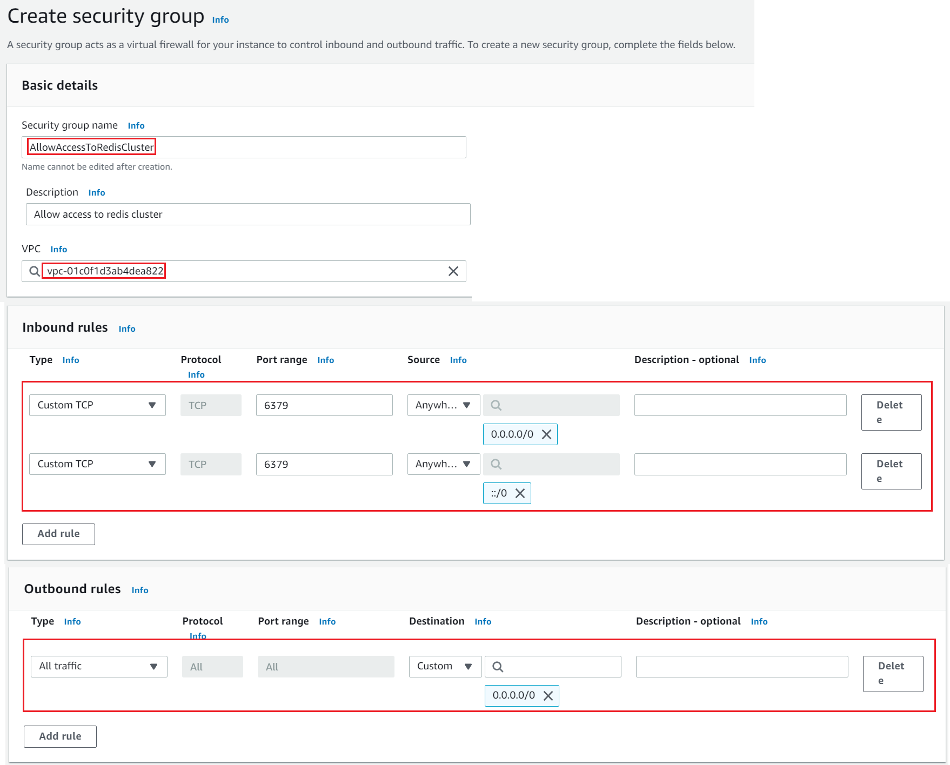
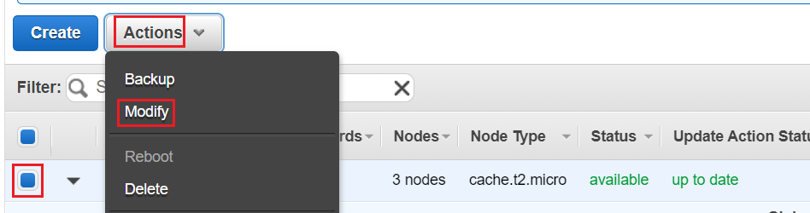
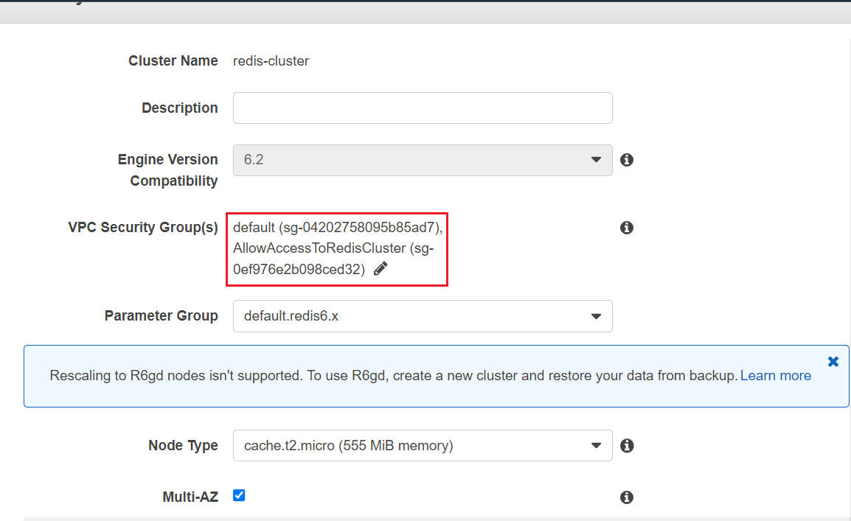
ElastiCache Service
    Authorize access to the cluster
Create Security group
Grant Security group to Cluster

Slide 11
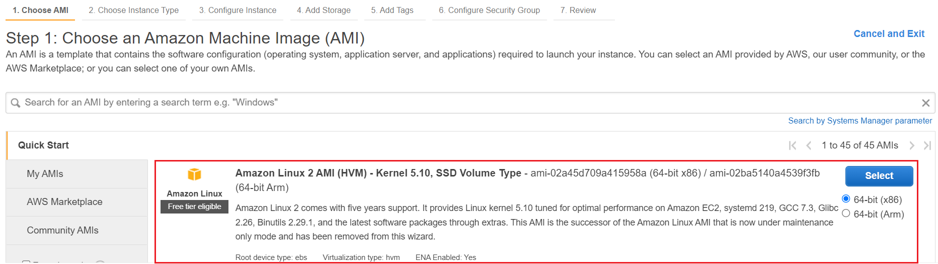
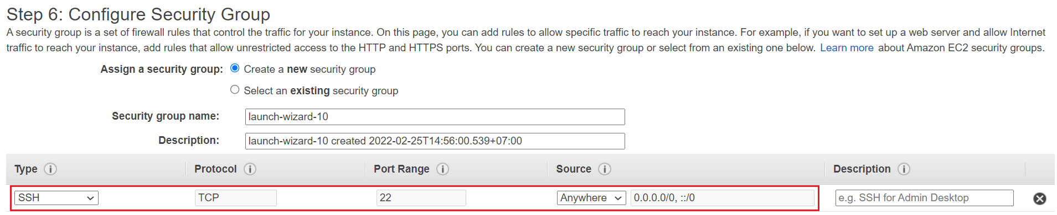
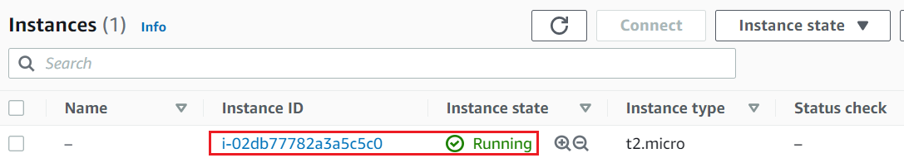
ElastiCache Service
    Launch EC2

Slide 12
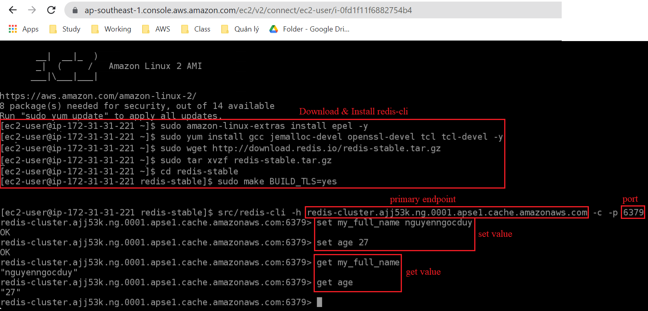
ElastiCache Service
    Connect to Cluster from EC2 Instance
Redis commands: https://gist.github.com/LeCoupa/1596b8f359ad8812c7271b5322c30946

Slide 13
Assignment
  Self-practice

Slide 14
ElastiCache Service
  Components
    Global Datastore
    Cluster
    Shard
    Node
    Endpoint
    Redis-cli
    Event

Slide 15
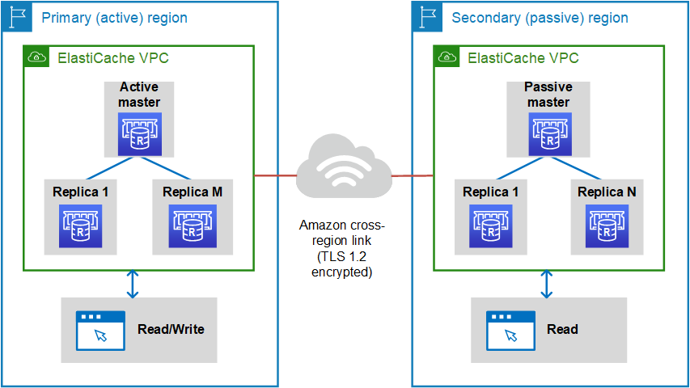
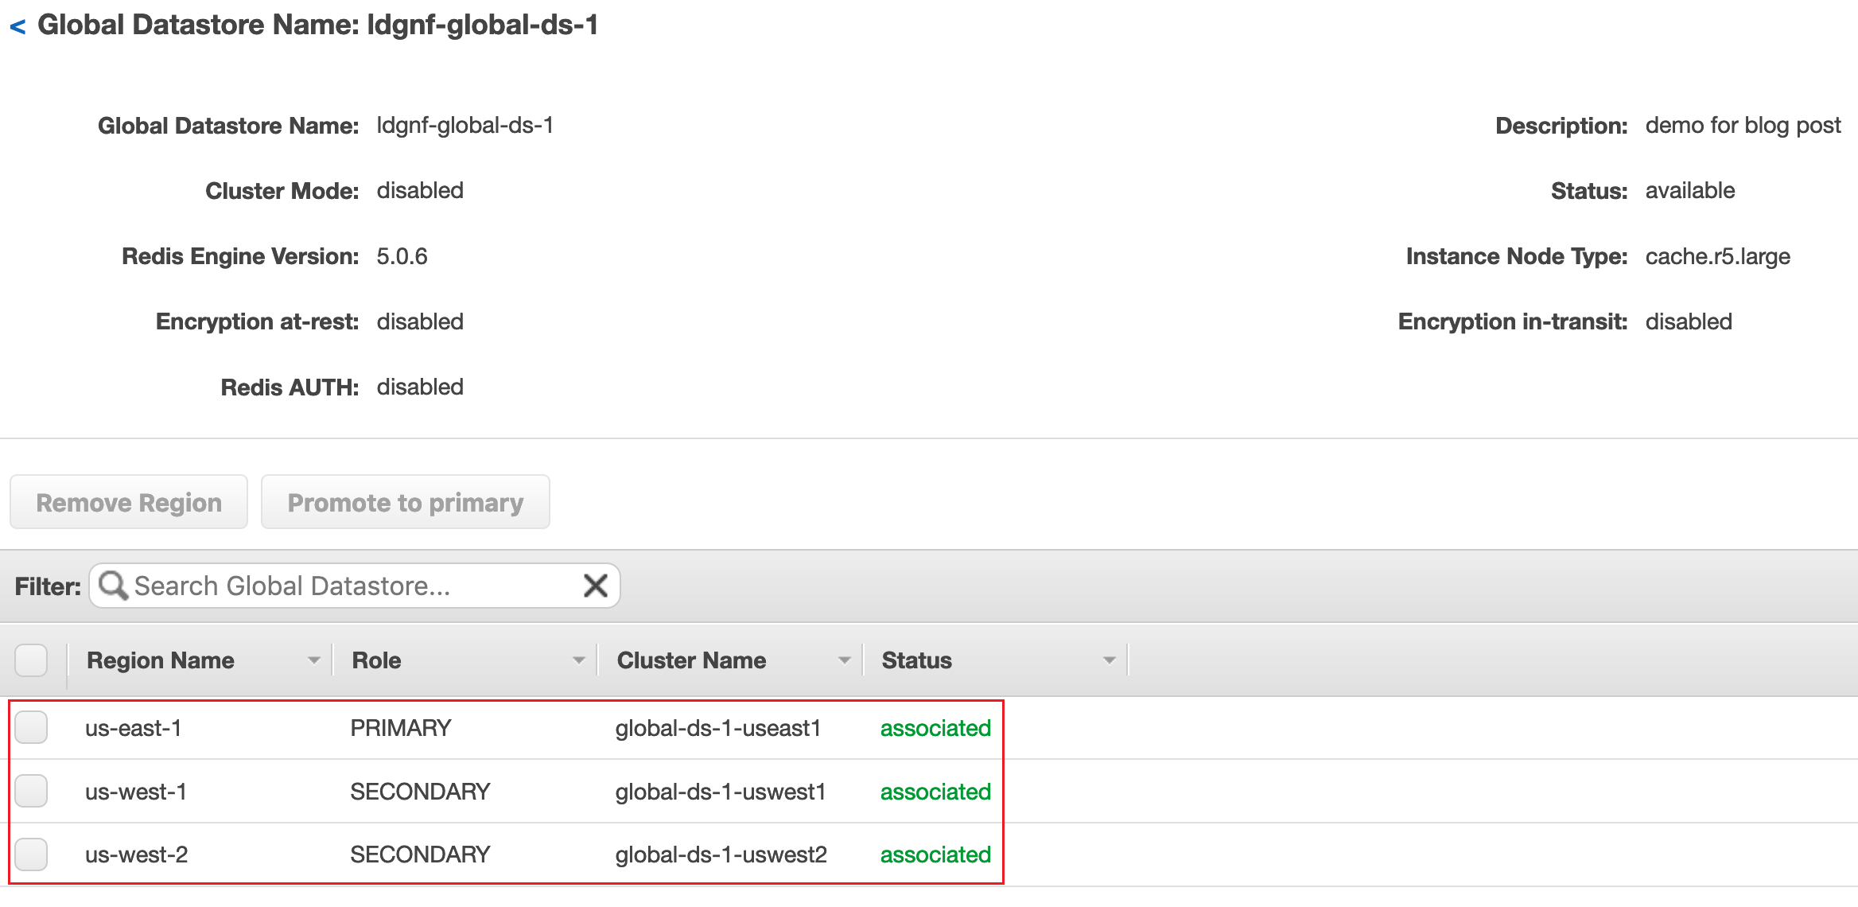
ElastiCache Service
    Global Datastore
      Including list of cluster that is replicated across multiple regions
    Cluster
      Working in a region
      2 types:
        Primary (active) cluster: Using for reading/writing request
        Secondary (passive) cluster: Using for only reading request
Global Datastore

Slide 16
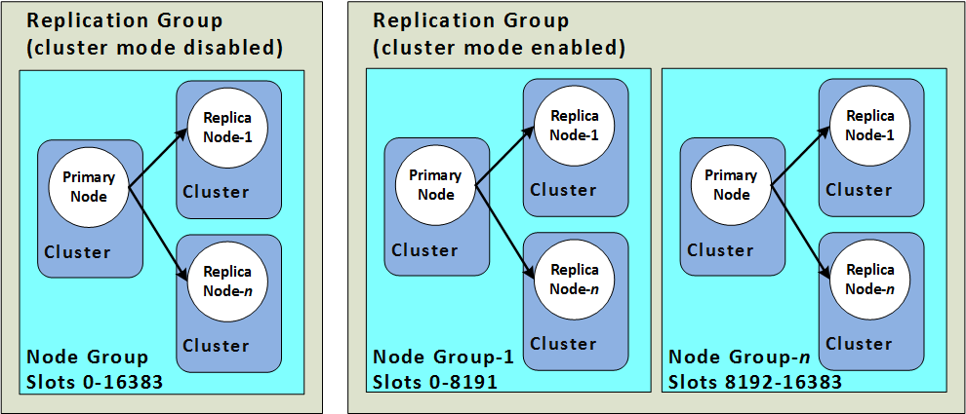
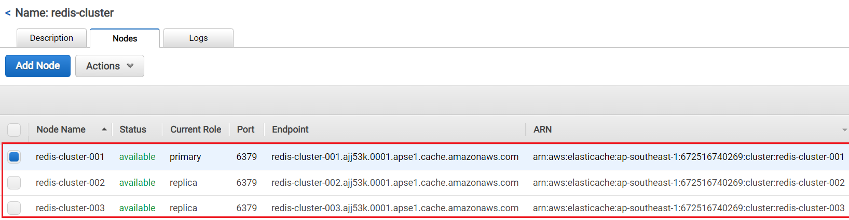
ElastiCache Service
    Shard (Node Group)
      Is group of nodes
      Max 500 shard
      Max 6 nodes in a shard (1 primary + 5 replicas)
    Node
      Is ElastiCache Instance (Similar to EC2 Instance)
      Support Reserved & On-demand Instance
      Nodes must have the same instance type & cache engine
      2 types: Primary Instance (Read/Write), Read replica (Reading)
Shard
Node

Slide 17
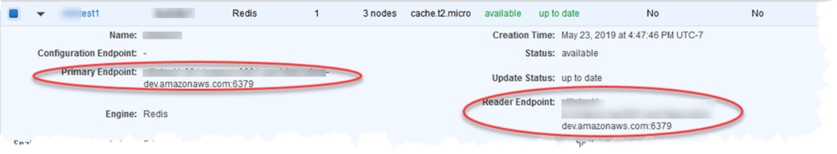
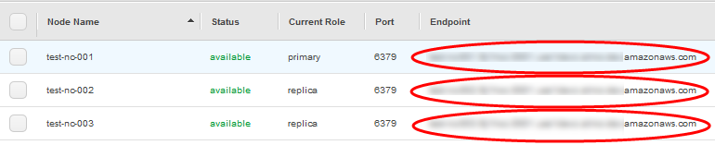
ElastiCache Service
    Endpoint
      Provide DNS name (Endpoint) and Port for Application on EC2 Instance to access
      If the cluster has only 1 node 🡺 That node is the primary instance, Endpoint will use for both reading/writing request
      If the cluster has only 1 shared 🡺 Primary Endpoint use for writing request & Reader Endpoint use for read
Primary Endpoint & Reader Endpoint
Node Endpoint

Slide 18
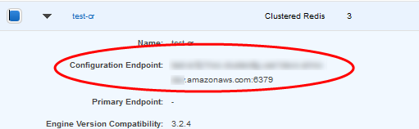
ElastiCache Service
      If the cluster has many shared 🡺 Configuration Endpoint use for both reading/writing request (you can still access each endpoint node)
Configuration Endpoint
    Redis-cli
      Installed on the application to access the cluster
      Redis commands: Link

Slide 19
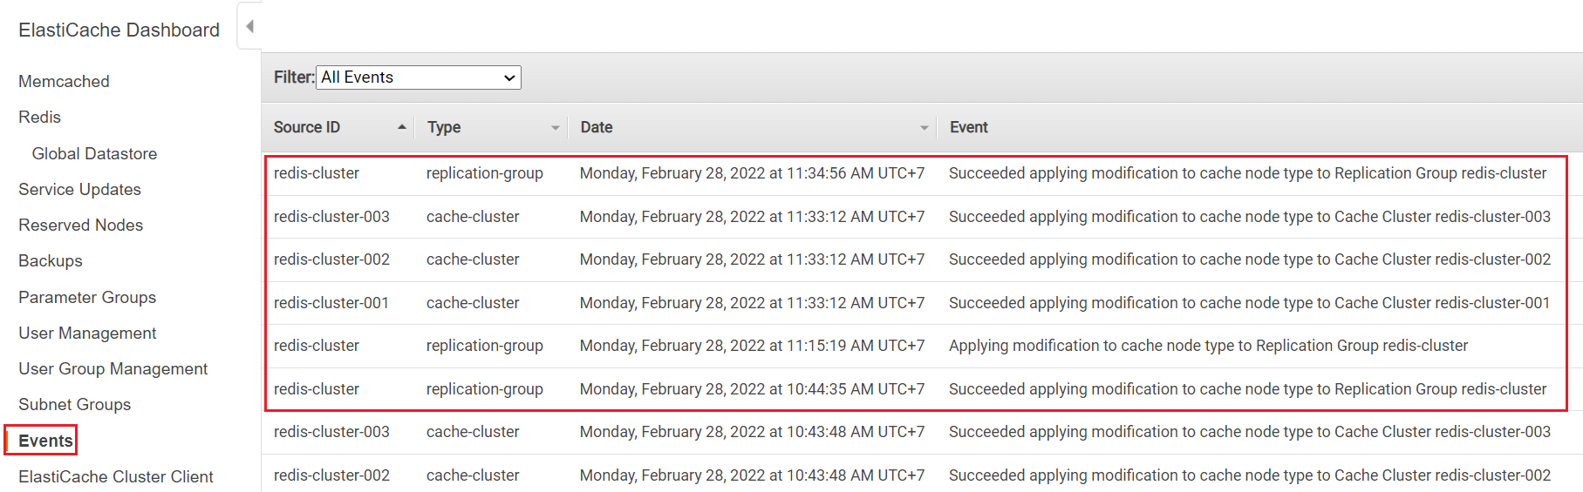
ElastiCache Service
    Event
      Show event history

Slide 20
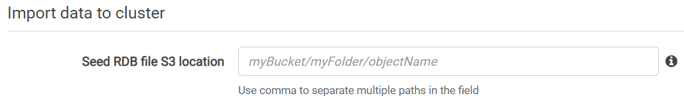
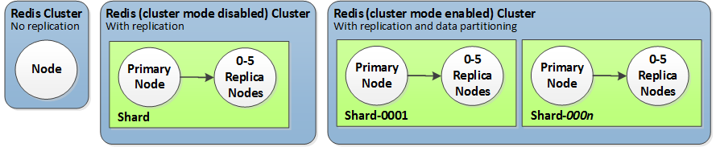
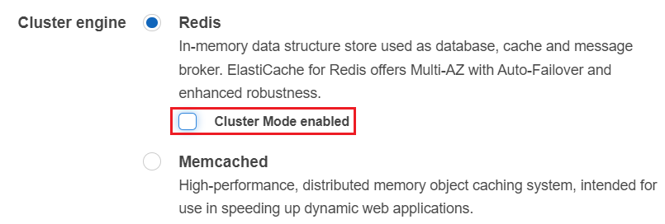
ElastiCache Service
  Settings
    Import data to cluster from RDS file saved on S3
    Cluster mode
      Disabled: Single-node or Multi-node (single shared)
      Enabled: Multi-shared
    Multi-AZ & Auto-Failover
      When there is a problem with the Primary Instance, it will automatically assign the Replica Instance to be Primary Instance
Import data from RDS file
Cluster mode

Slide 21
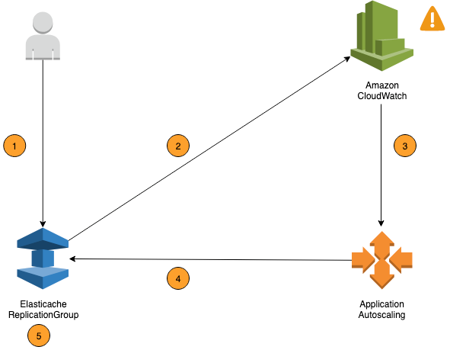
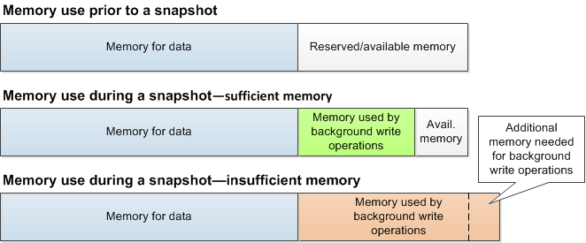
ElastiCache Service
    Auto Scaling
      Automatically increase/decrease the size of shard or replica in a cluster
      Does not support Global Datastore
      2 types
        Dynamic scaling (Target tracking scaling policies): based on metric of CloudWatch
        Scheduled scaling: based on date & time
    Backup & Restore
      Automatic / Manual, S3, retention period (1 🡪 35 days)
      You can restore new cluster from snapshot
Auto Scaling
Tutorial: Link
On the instance, make sure there is enough RAM to take the snapshot

Slide 22
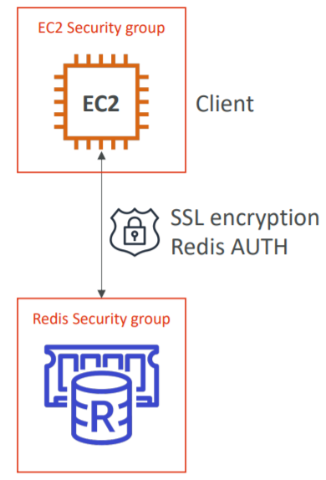
ElastiCache Service
    Security groups
    ACL (Access Control List)
      Do not support IAM authentication
      3 types
        No Access Control: everyone can access cluster
        User Group Access Control List: only users in the group can access cluster
        Redis AUTH Default User: set a “password/token” when creating a Redis cluster
    Encryption: In transit – SSL / At rest
      ACL Tutorial: Link

Slide 23
ElastiCache Service
    Monitoring: CloudWatch
    Maintenance
    Append only files (AOF)
      By default, the data in a Redis node on ElastiCache resides only in memory and isn't persistent 🡺 If a node is rebooted, or if the underlying physical server experiences a hardware failure, the data in the cache is lost.
      You can save data to file with AOF
      Not support t1 and t2 nodes
      Tutorial: Link

Slide 24
ElastiCache Service
    Caching strategy
      Lazy loading
        If there is no data in the cache 🡺 then query to the database to get data
        All the read data is cached, data can become stale in cache
      Write-through: Adds or update data in the cache when written to a DB (no stale data)
      Session Store: store temporary session data in a cache (Add TTL - time to live)
      Caching strategy Tutorial: Link

Slide 25
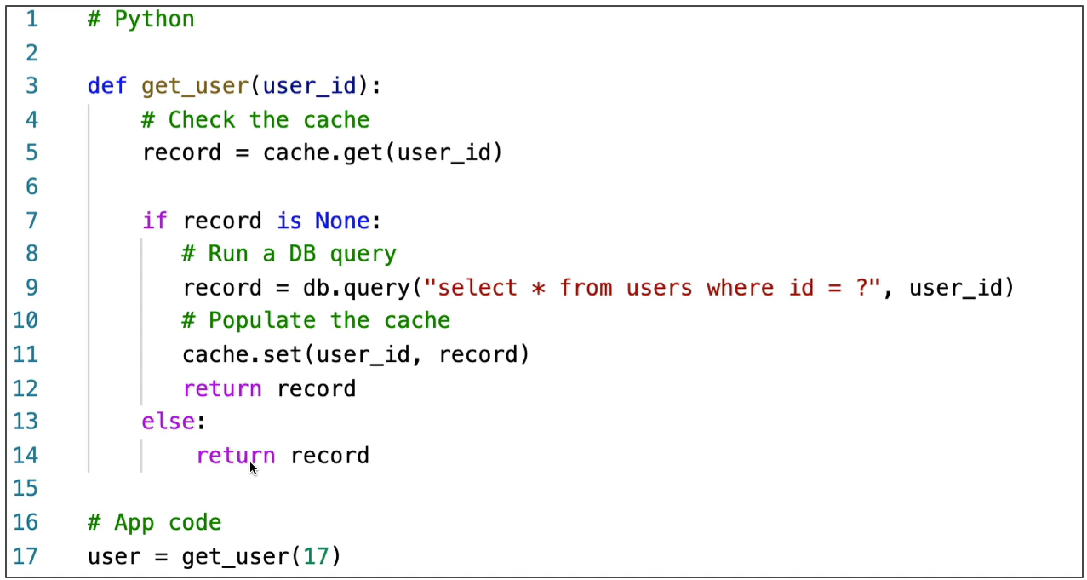
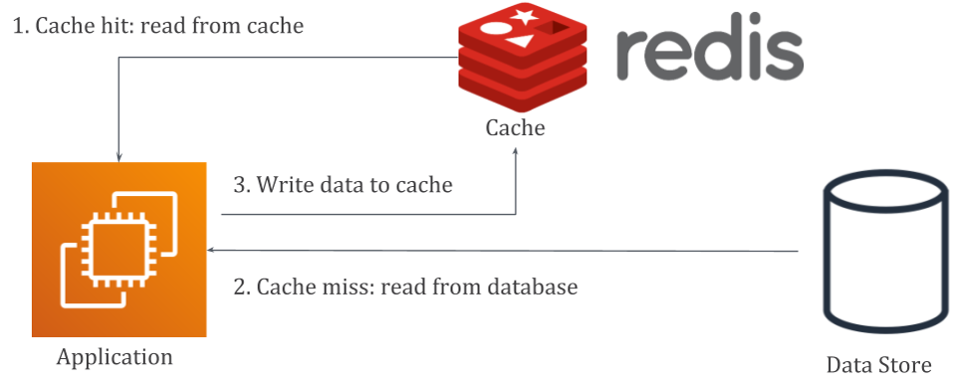
ElastiCache Service
      Lazy Loading

Slide 26
Assignment
  Self-practice

Slide 27
ElastiCache Service
Memcached
  Similar to Redis, support
    Nodes
    Multi-AZ & Auto-Failover, Auto scaling
    DNS name & Port
    Provide only configuration endpoint, default port: 11211
    Caching strategy
    Monitoring
  Not support
    Shard, Global Datastore
    Append only files (AOF)
    User & Group
    Backup & Restore, Encryption
    Import data from S3
https://docs.aws.amazon.com/AmazonElastiCache/latest/mem-ug/WhatIs.html

Slide 28
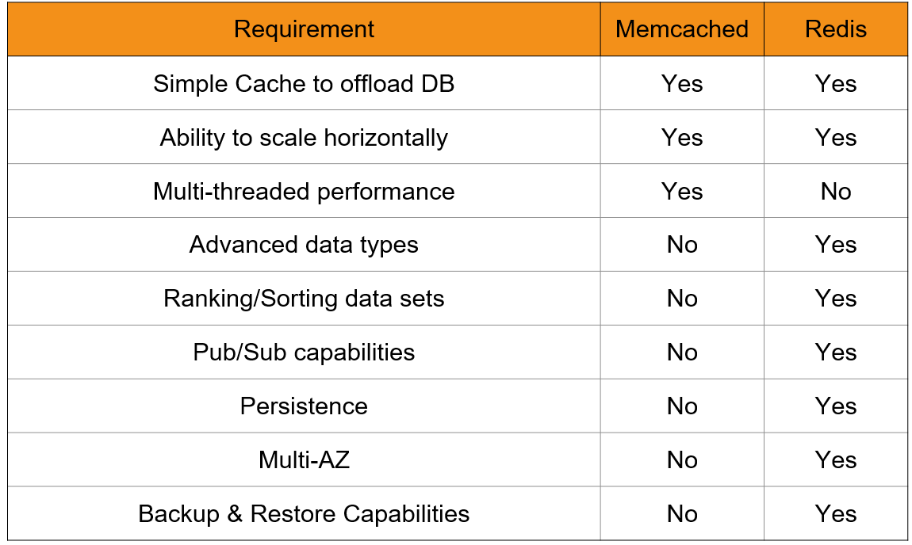
ElastiCache Service
Comparing Redis & Memcached
  Memcached
    Save simple datatype as value-key
    Support multi-thread
  Redis (recommended)
    Save more complex datatypes like String, hash, set, ...
    More features than Memcached
    Not support multi-thread
https://docs.aws.amazon.com/AmazonElastiCache/latest/red-ug/SelectEngine.html

Slide 29
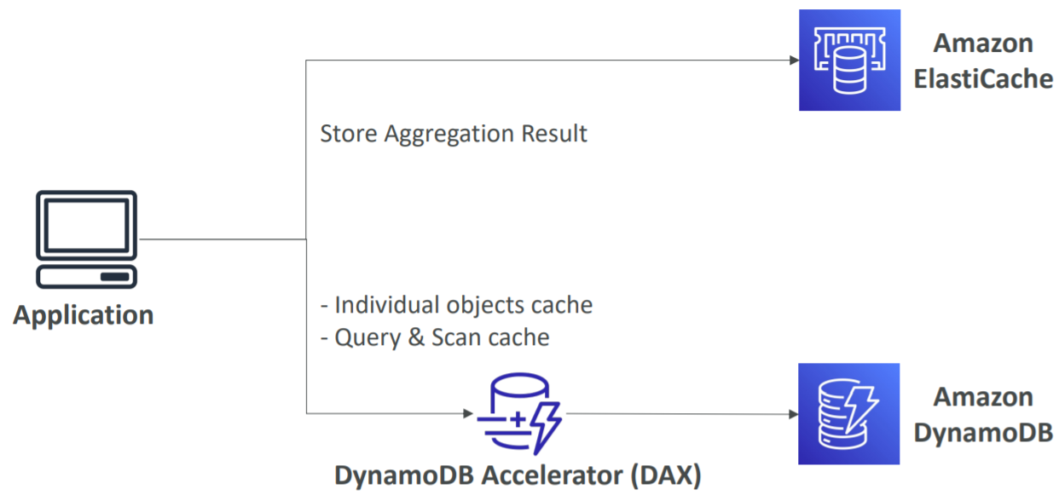
ElastiCache Service
Compare ElastiCache & DAX - DynamoDB

Slide 30
Summary
ElastiCache is an distributed in-memory cache environments in the AWS Cloud
Storing data on RAM, Key-value format
High performance, low latency, resizable, and cost-effective in-memory cache
Support Redis and Memcached engines
Usecases: Accelerate application performance, Ease database load, Build low-latency data stores
Redis components: Global Datastore, Cluster, Shard, Node, Endpoint, Redis-cli

Slide 31
Summary
Features
  Import data to cluster from RDS file saved on S3
  Multi-AZ & Auto-Failover, Auto Scaling, Backup & Restore, Security groups, ACL, Encryption, Monitoring, Maintenance, … similar to EC2 instance
  Append only files (AOF)
  Caching strategy: Lazy loading, Write-through, Session Store

Slide 32
Summary
Comparing Memcached & Redis
  Memcached
    Save simple datatype as value-key
    Support multi-thread
  Redis
    Save more complex datatypes like String, hash, set, ...
    More features than Memcached
    Not support multi-thread

Slide 33
Q & A
Copyright © VTI Academy All Rights Reserved

